Slide 1
Agenda
Quantized-state solver (QSS) of a continuous system in a discrete event framework (JIFSO)
by
Major Mongi Bellili
Introduction | Off-the-shelf solutions | QSSolver.jl prototype | Future work

Slide 2
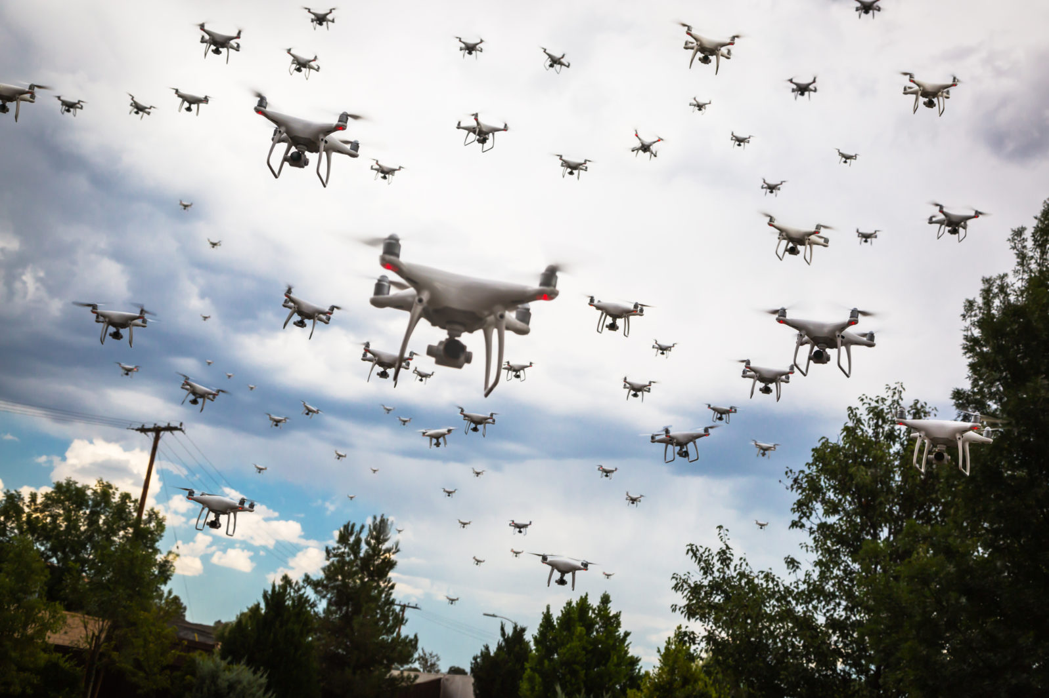
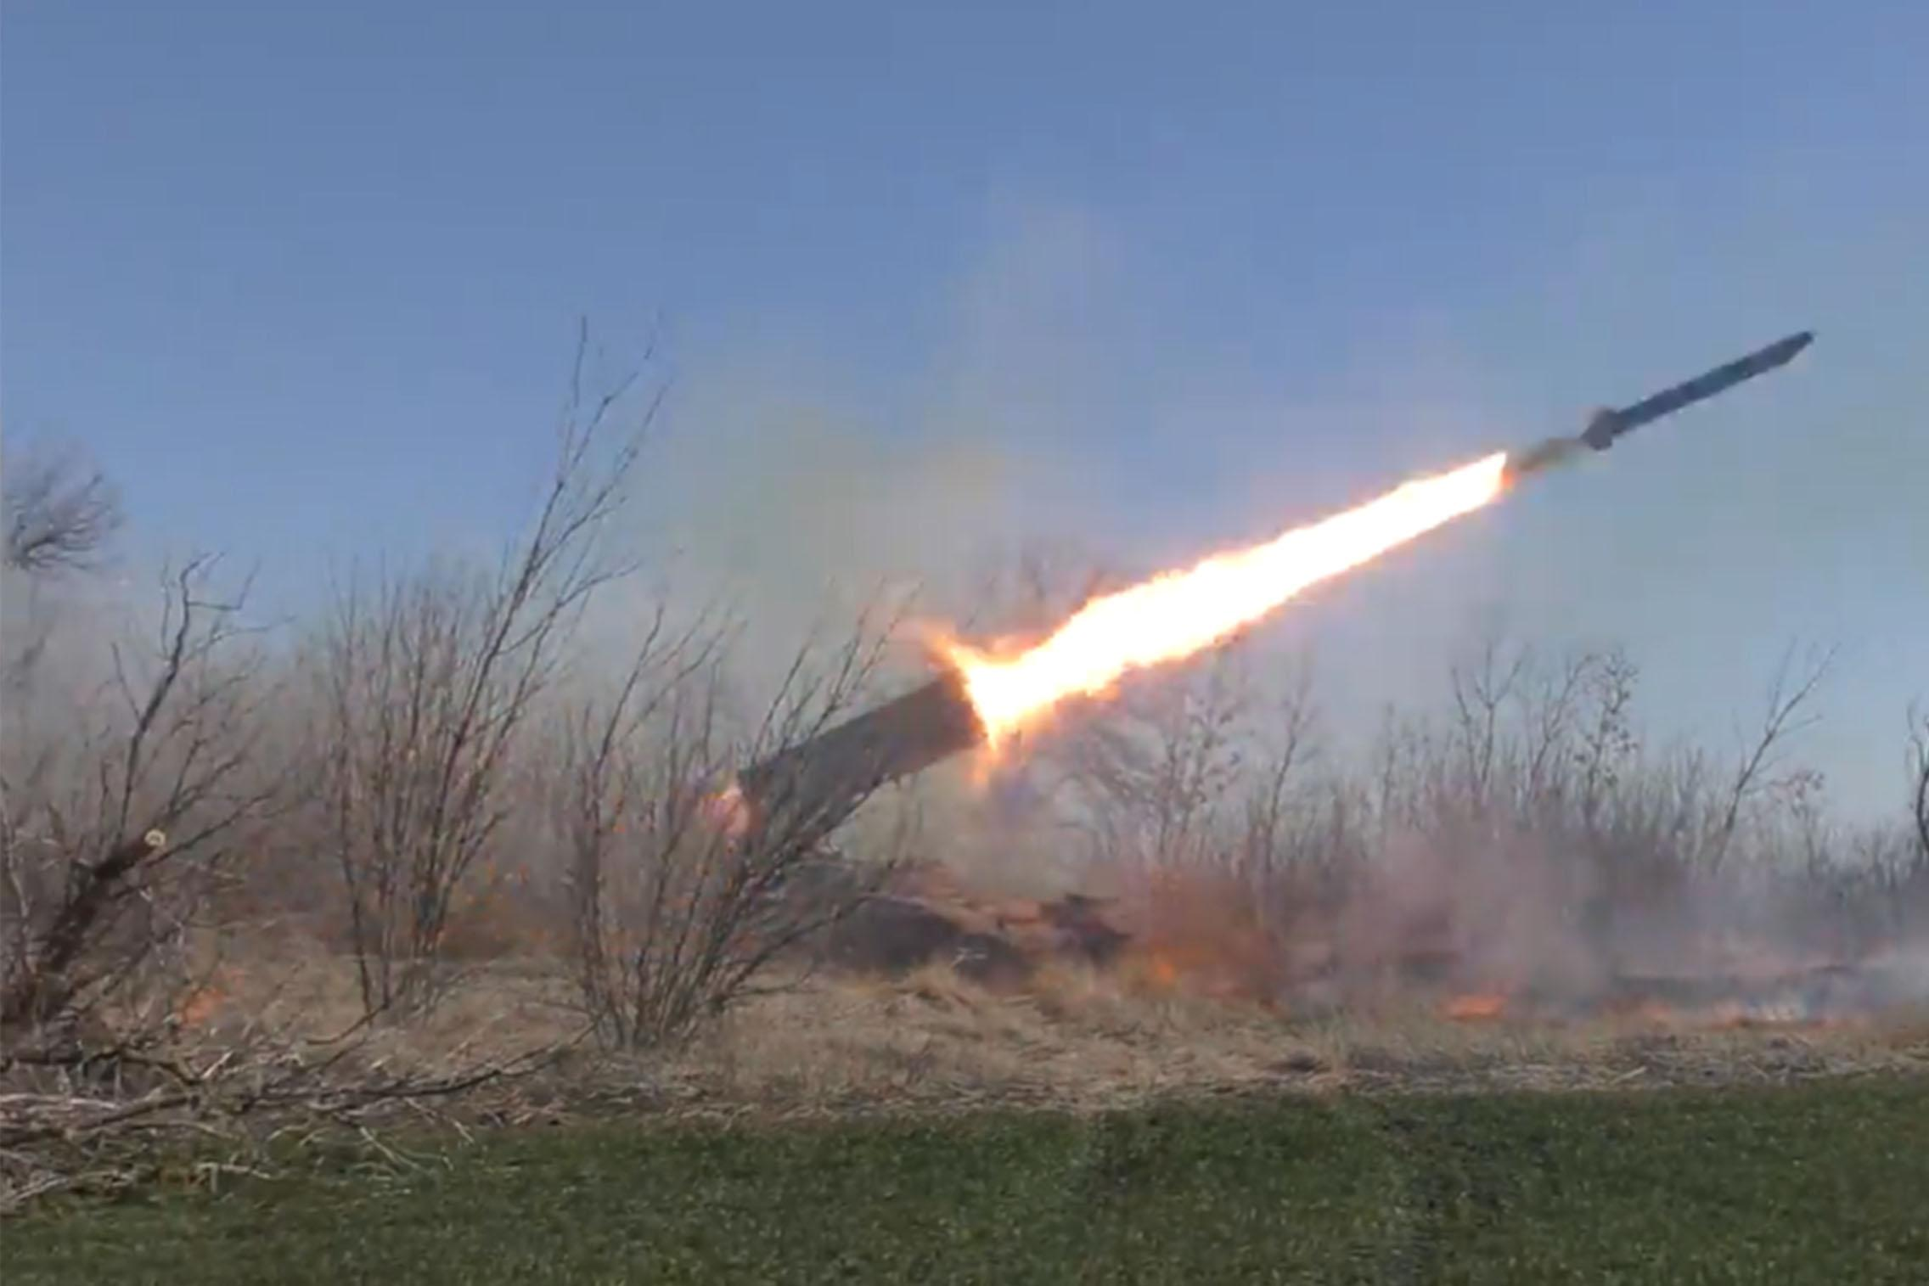
Introduction | Off-the-shelf solutions | QSSolver.jl | Future work
The complexity of real problems
Costly or infeasible approaches
Simulation

Slide 3






















Introduction | Off-the-shelf solutions | QSSolver.jl | Future work
Tools and environments
Solvers
JIFSO
QSSolver.jl

Slide 4
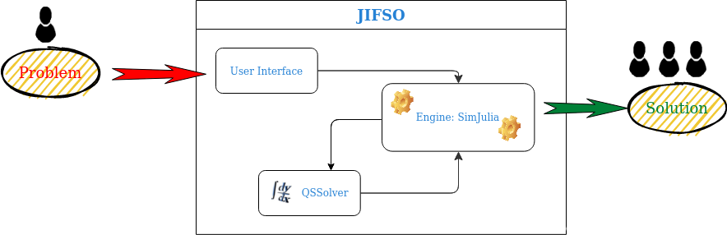
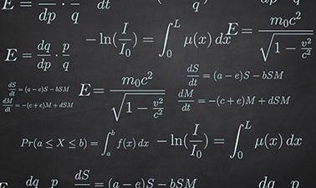
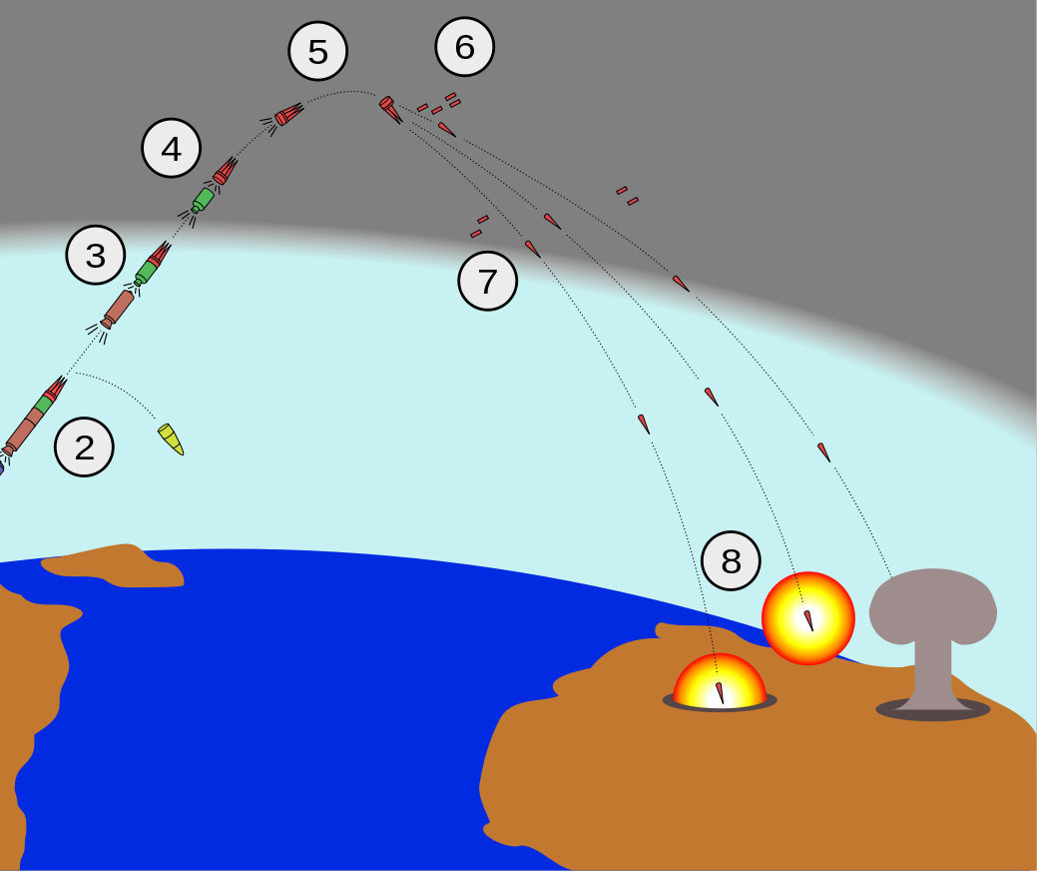
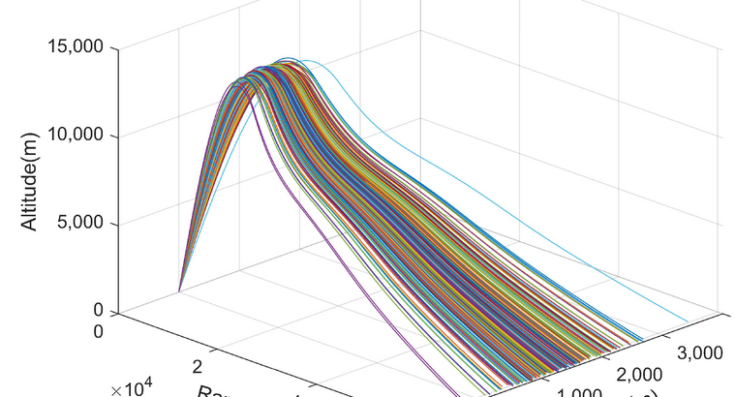
Introduction | Off-the-shelf solutions | QSSolver.jl | Future work

Slide 5
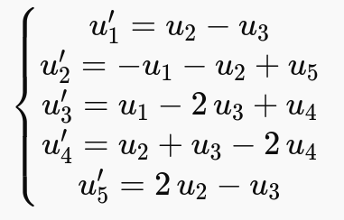
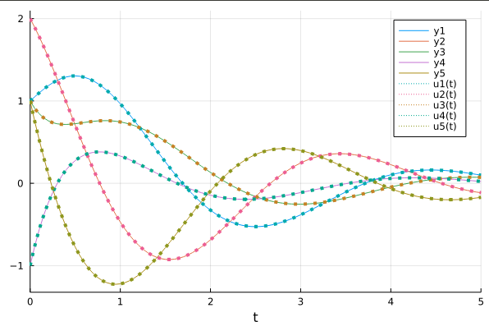
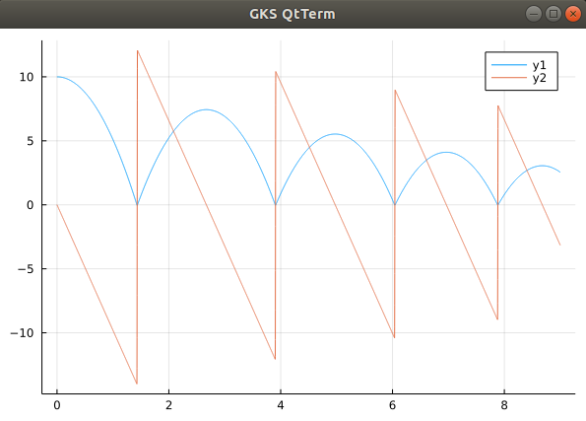
Introduction | Off-the-shelf solutions | QSSolver.jl | Future work
Test1: System of 5 differential equations with Inititial conditions: [1.0,2.0,1.0,-1.0,1.0] and absolute tolerance = 1e-6
QSSolver
89.174 μs and 21.66 KiB)
Diff-equ package:
104.782 μs and 61.52 KiB
Test2: 2 differential equations with Inititial conditions: [10,0.0] and contains discrete events: bouncing ball system

Slide 6
Introduction | Off-the-shelf solutions | QSSolver.jl | Future work
User Interface
Implement other methods
Add intelligence and features
Thank you!

